Slide 1

PROJECT Where is Shuttle Bus?
Final Presentation
Made by Group 2
Leader GIBEOM KIM
Member1 HYEJI SHIM
Member2 JIYUN LEE
Member3 EUNJAE LEE

Slide 2
Contents
∙ Introduction
∙ Planning
∙ Demonstration
∙ Summary

Slide 3








Introduction
<Driver ver.>
<Customer ver.>

Slide 4



Planning
Where is
MyongJi
shuttle bus?!

Slide 5

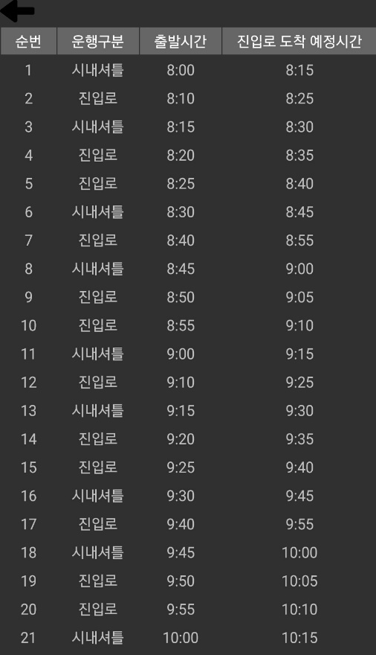

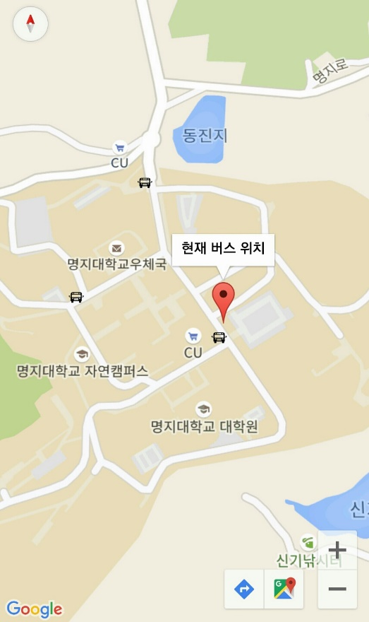
Demonstration

Slide 6
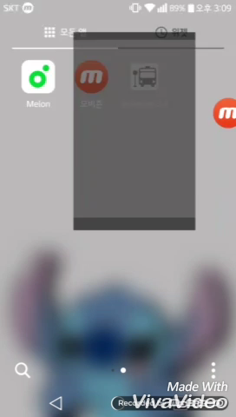
Demonstration
https://youtu.be/lKHJ7bqBfl8

Slide 7
Summary
- GCM & Google Map
- Real time location tracking
- Intuitive UI
GitHub URL: https://github.com/GiBeomKim/2016-2_Embeded_System/tree/master/TeamProject

Slide 8
Thank you for your attention
Final Presentation
Made by Group 2
Leader GIBEOM KIM
Member1 HYEJI SHIM
Member2 JIYUN LEE
Member3 EUNJAE LEE

